Slide 1
How to properly use the primary MRL Body Of Knowledge References
The Manufacturing Readiness Level (MRL) Body of Knowledge (BOK) consists of documents and tools that capture the current and primary references defining manufacturing readiness:
MRL Deskbook: Narrative document defining MRLs and Criteria, explaining Manufacturing Readiness Assessment (MRA) process and Manufacturing Maturation Plan (MMP) format, providing contracting language, and tailoring guidelines.
MRL Interactive User Guide: Interactive excel-based user guide developed to support MRL assessments, with cross referenced definitions, criteria, explanatory notes, best practices and MRL level appropriate questionnaires.
MRL Criteria Matrix: Excel spreadsheet containing all criteria, organized by MRL timeline (column) and subject thread (row).
Printable MRL Matrix: Same content as Criteria Matrix, above, but formatted for printing.
The MRL BOK are revised and updated through an annual process governed by the DoD MRL Working Group and informed by an annual MRL workshop.
As the MRL BOK are updated, previous versions are archived. The current and possibly the next most current version are displayed on the website front page with the older versions available on the archive page.
It is critical when utilizing the MRL BOK to properly consider and align the versions of the documents provided. The MRL BOK version alignment table contains a matrix that provides the alignment of the MRL BOK document versions.

Slide 2
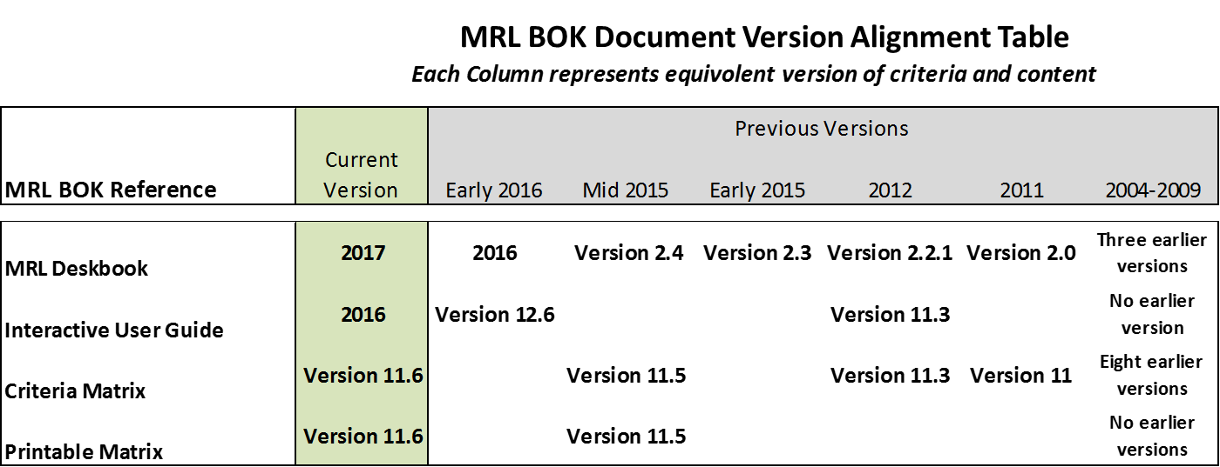
How to properly use the primary MRL Body Of Knowledge References

